Slide 1
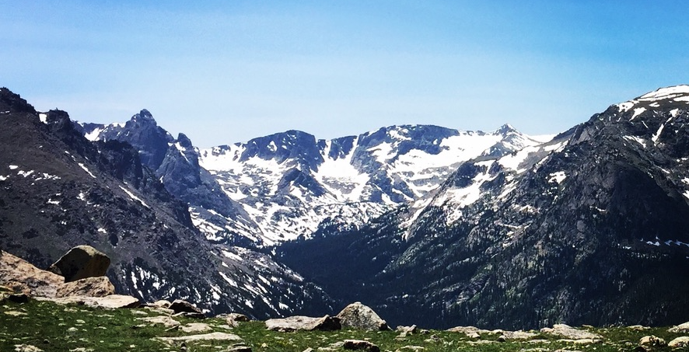
Introduction to Programming & Logic
UNM Earth Sciences Computing & Programming Experience
Aug 8 – 19, 2022
Instructors:
Eric Lindsey, Lindsay Worthington, Brandon Schmandt, Mousumi Roy, Jeng Hann Chong, Evans Onyango

Slide 2
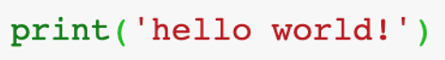
Programming is speaking to the computer in its own language
Computers speak through the language of logic.
If we can’t program, we depend on other people to write programs for us!
This means it’s hard to do new things… like science!
Modern Earth science (including geophysics) requires at least a bit of programming skills.
The more you learn, the more new things you’ll be able to do!
Note: all languages take time to master! Be patient with yourself.

Slide 3
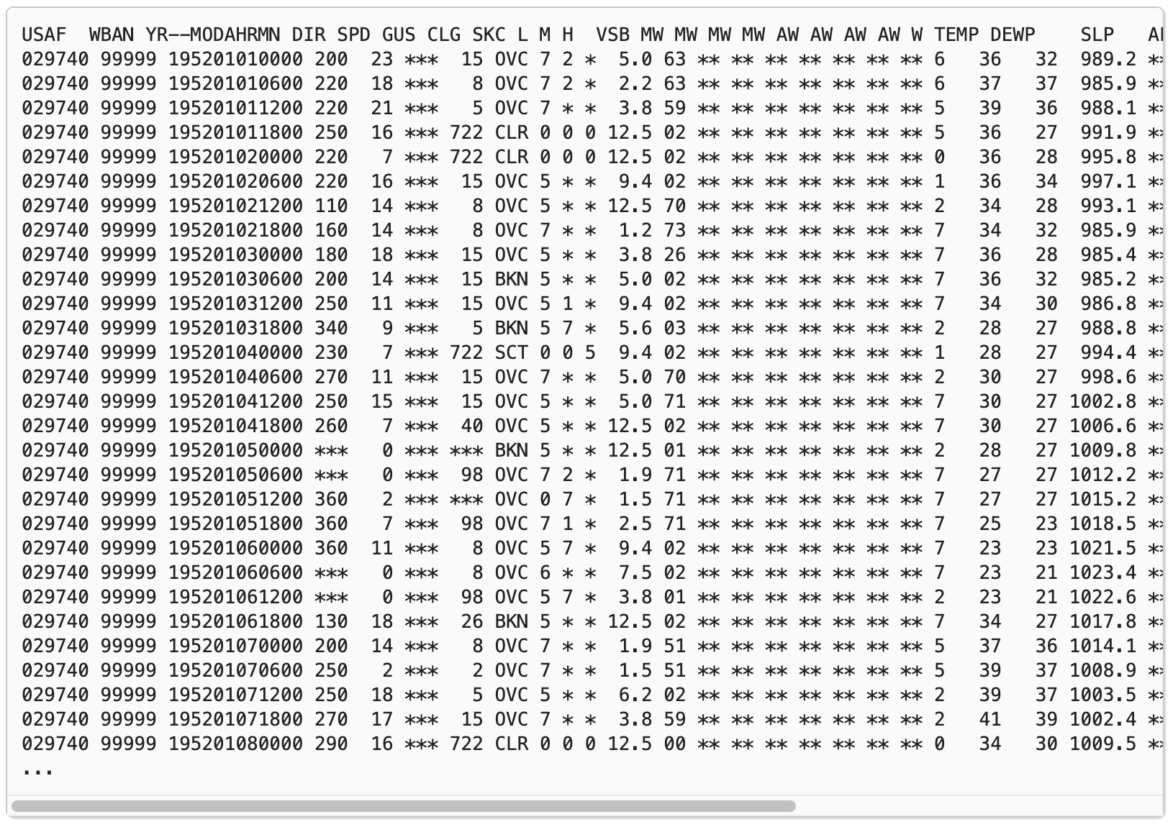
Programming lets us visualize data
Global climate data: is this a useful way to view the data?
https://geo-python-site.readthedocs.io/

Slide 4
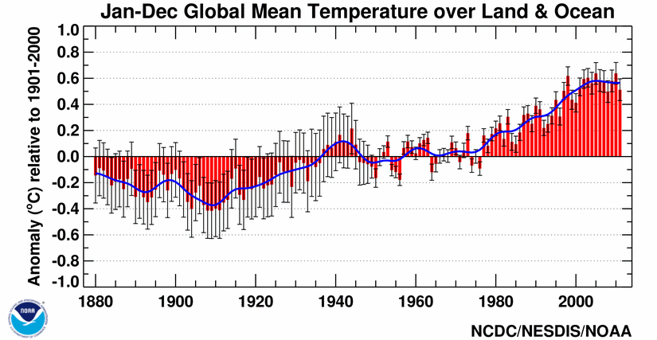
Programming lets us visualize data
How about this:
https://geo-python-site.readthedocs.io/

Slide 5
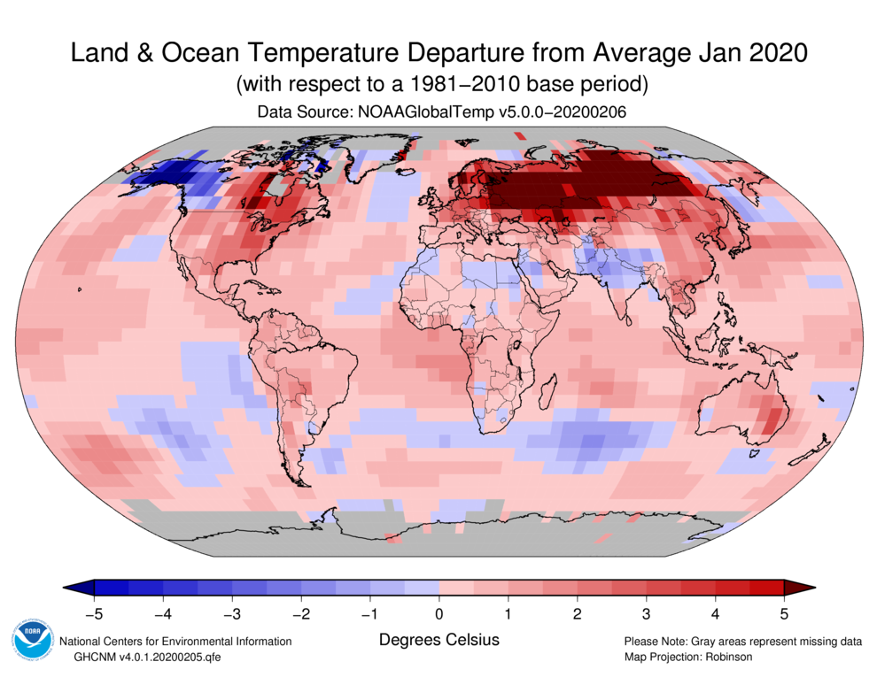
Programming lets us visualize data
Or this:
https://geo-python-site.readthedocs.io/

Slide 6
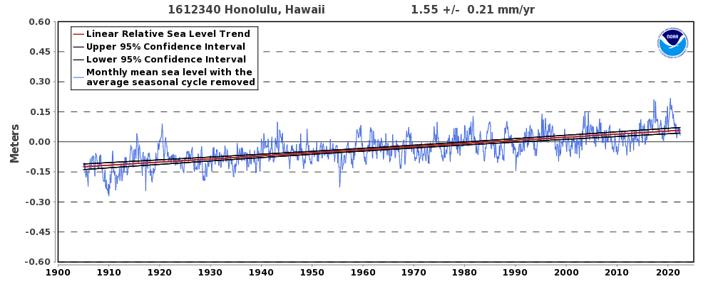
Programming helps us measure things we can’t observe directly
How fast is sea level rising?
Fitting a line is done by a computer program – we call this a (very simple) “model”
https://tidesandcurrents.noaa.gov/sltrends/

Slide 7
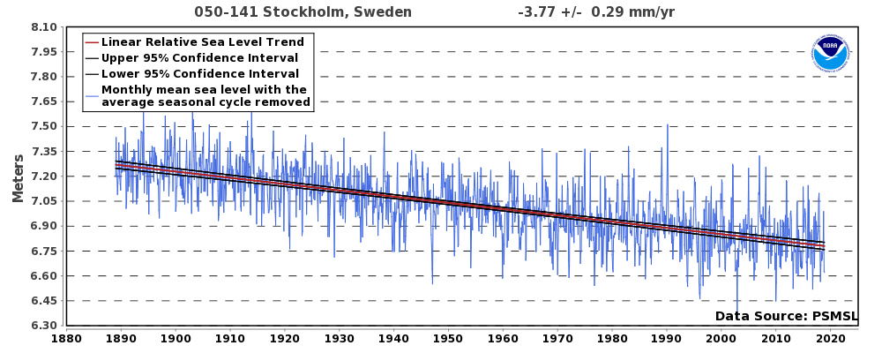
Programming helps us measure things we can’t observe directly
Sea level rise is not the same everywhere – why?
We need to analyze lots of data and make more complex models to find out why.
https://tidesandcurrents.noaa.gov/sltrends/

Slide 8
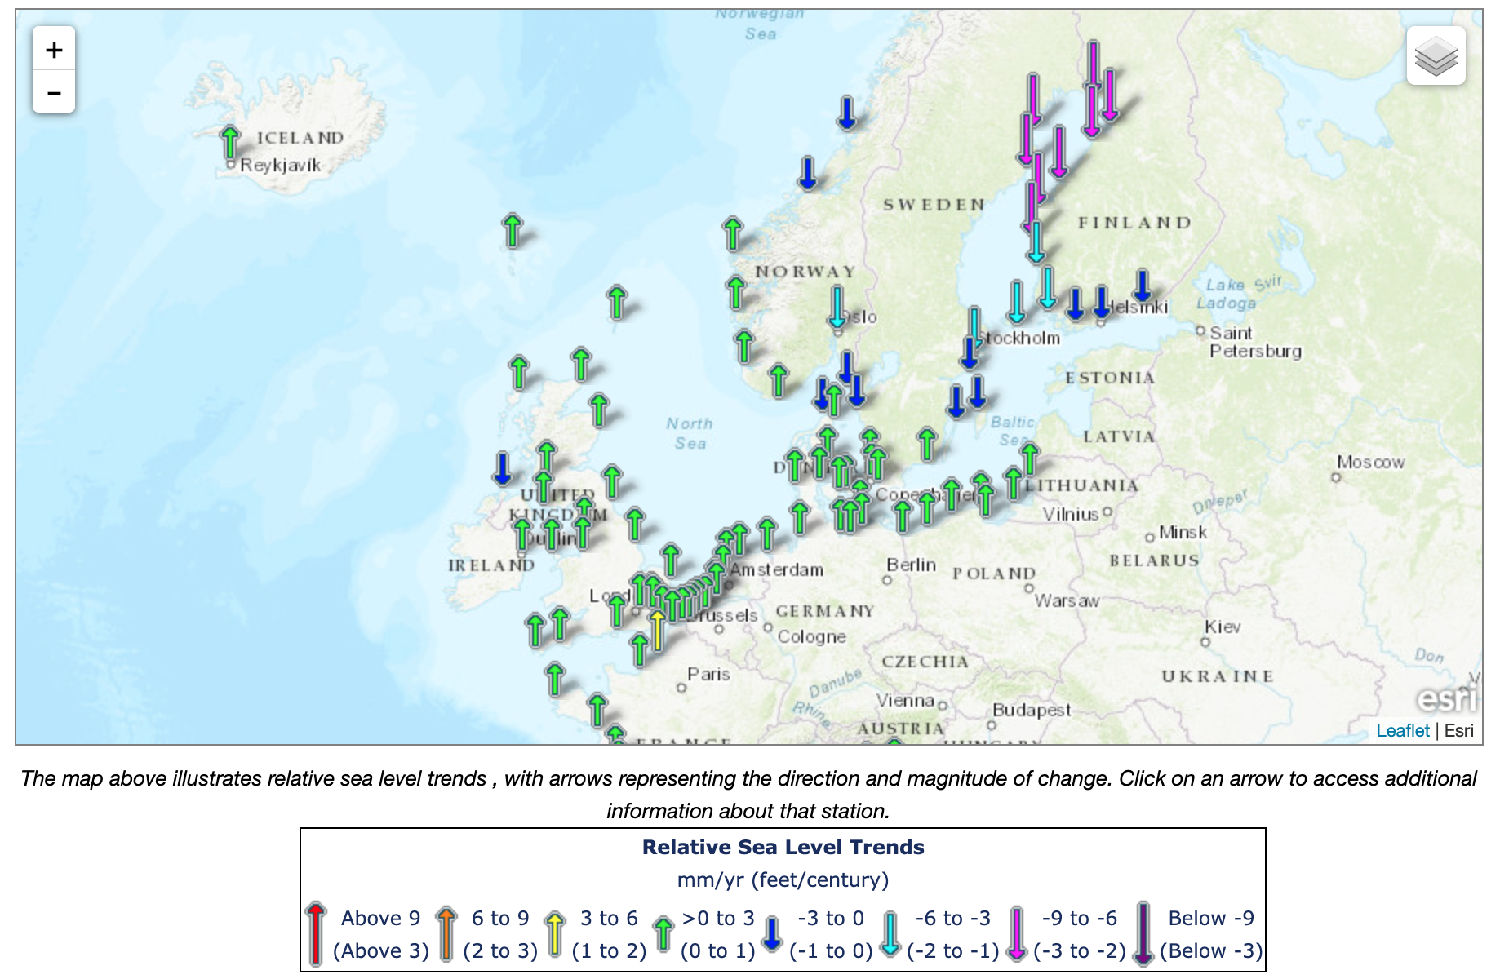
Programming helps us measure things we can’t observe directly
With enough data, we can interpret it on a map (also by writing a program), to help us understand the pattern.

Slide 9
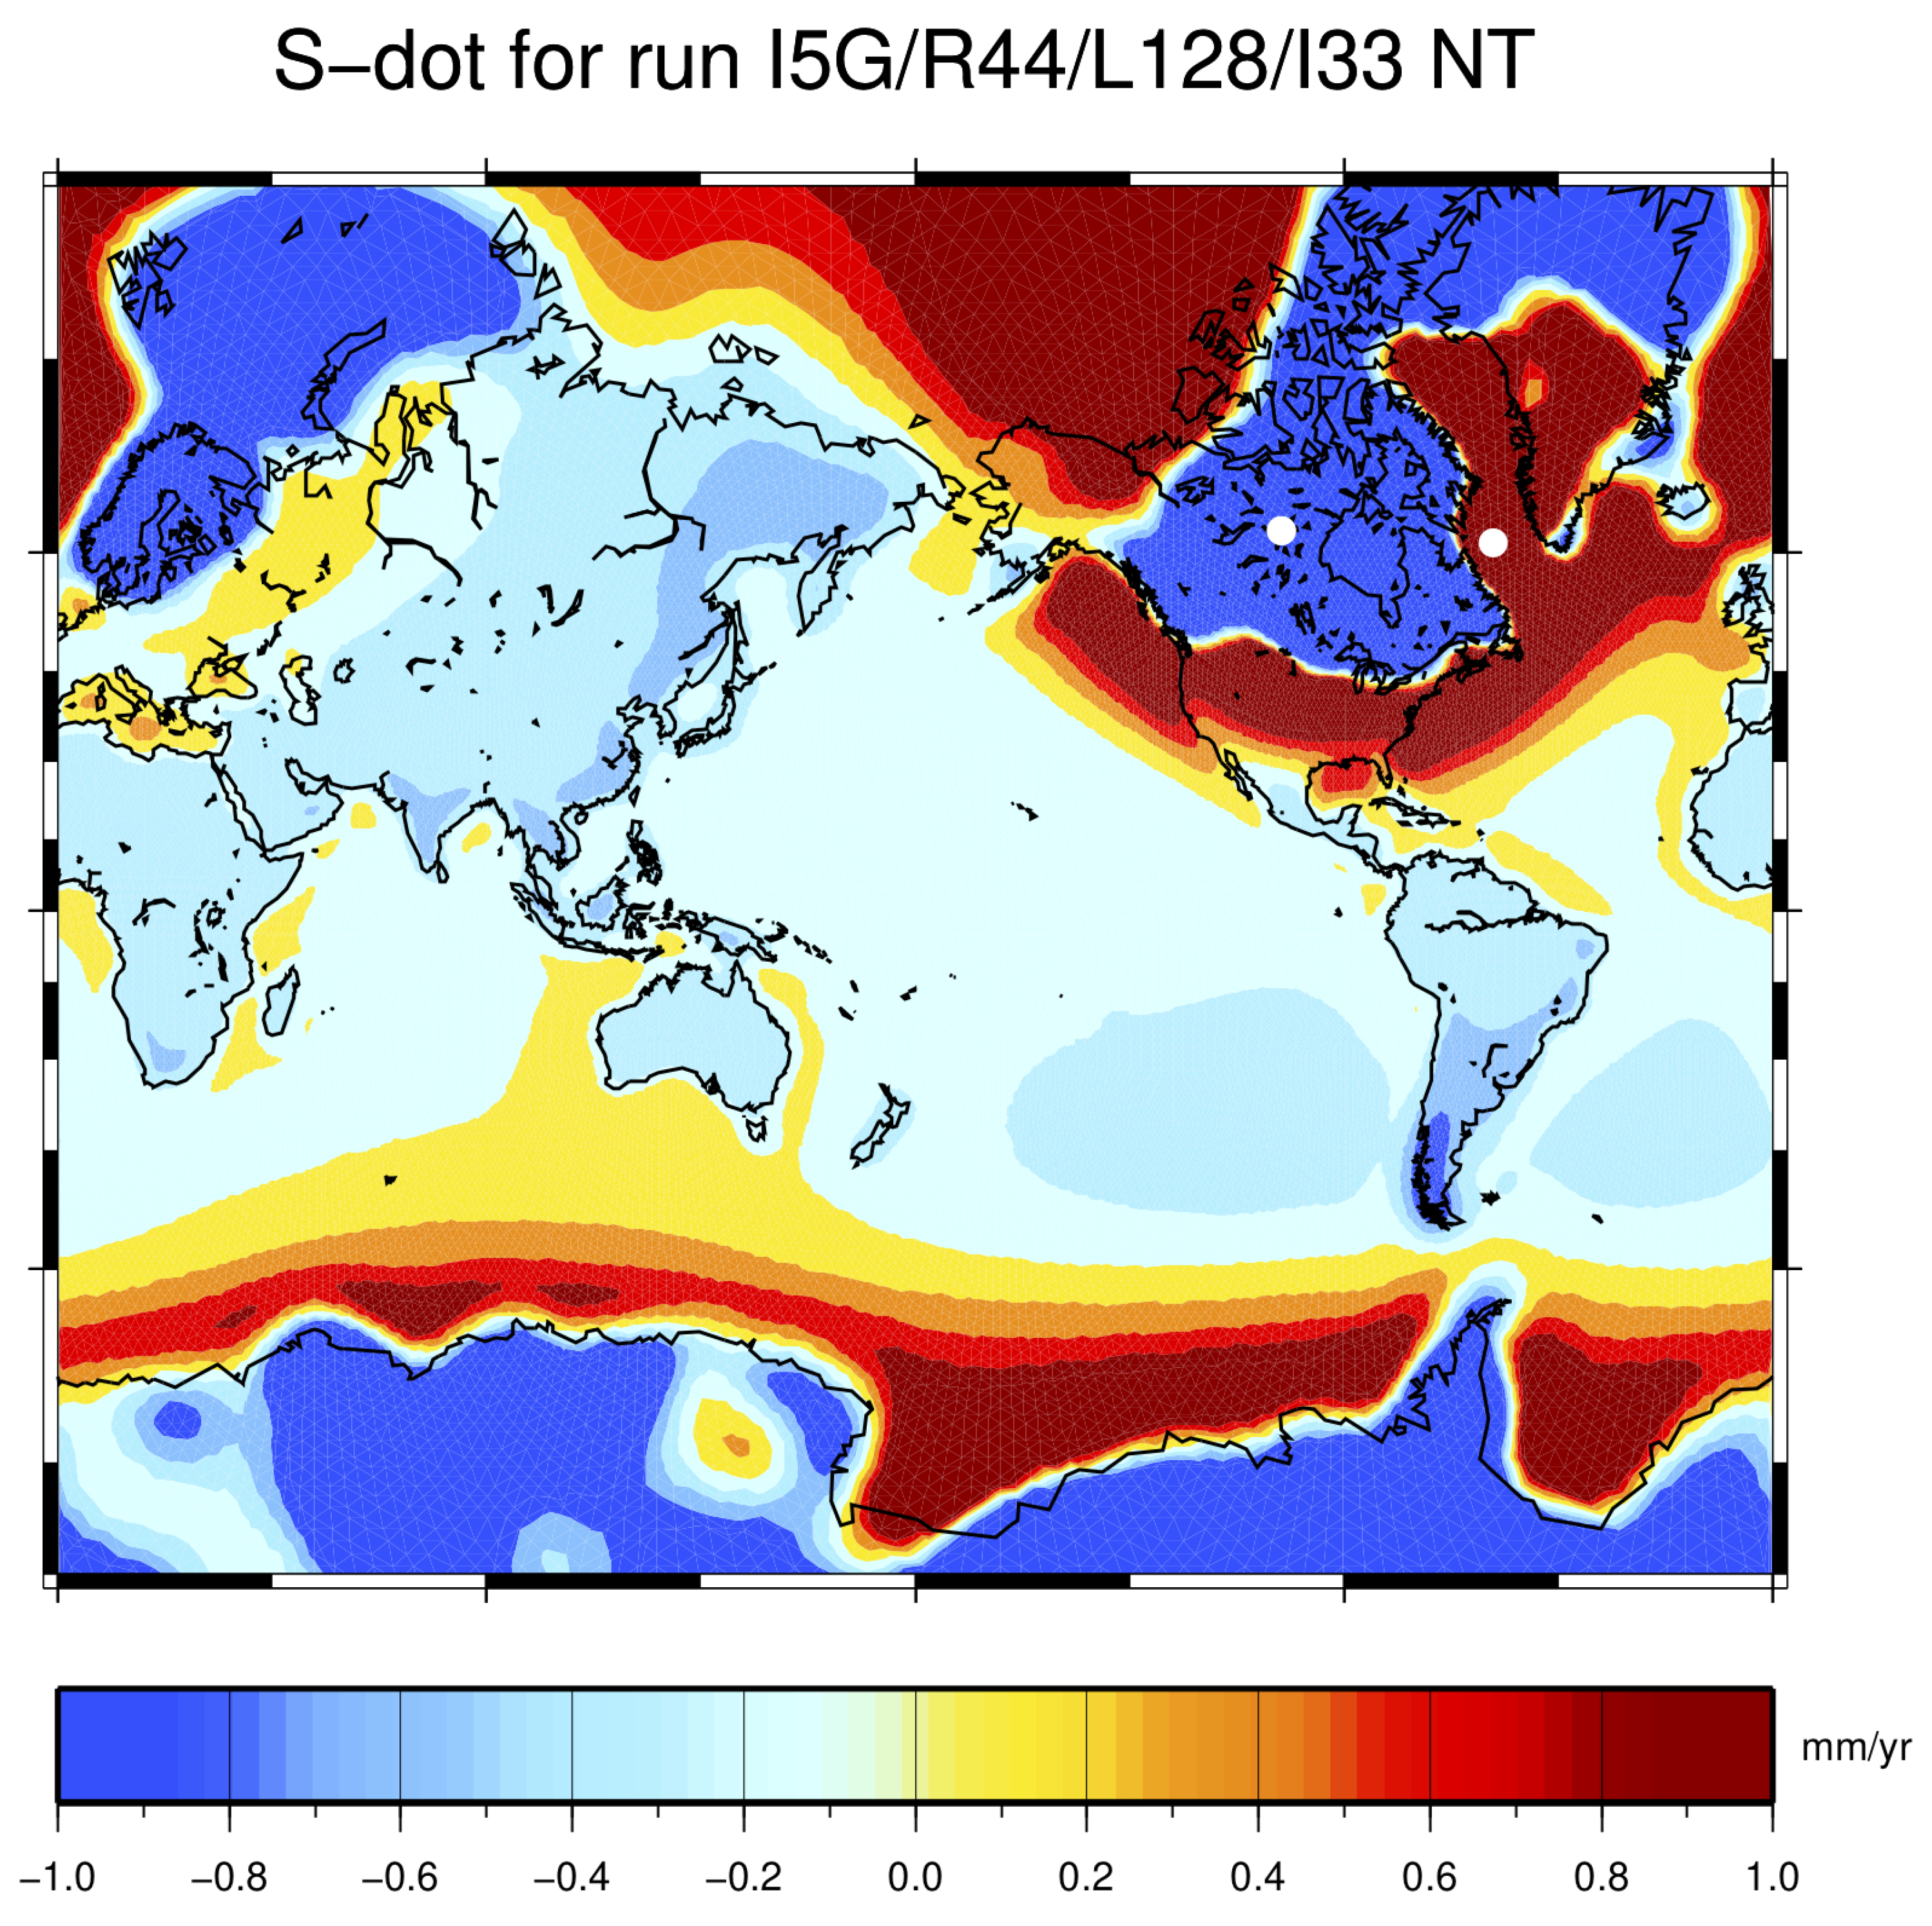
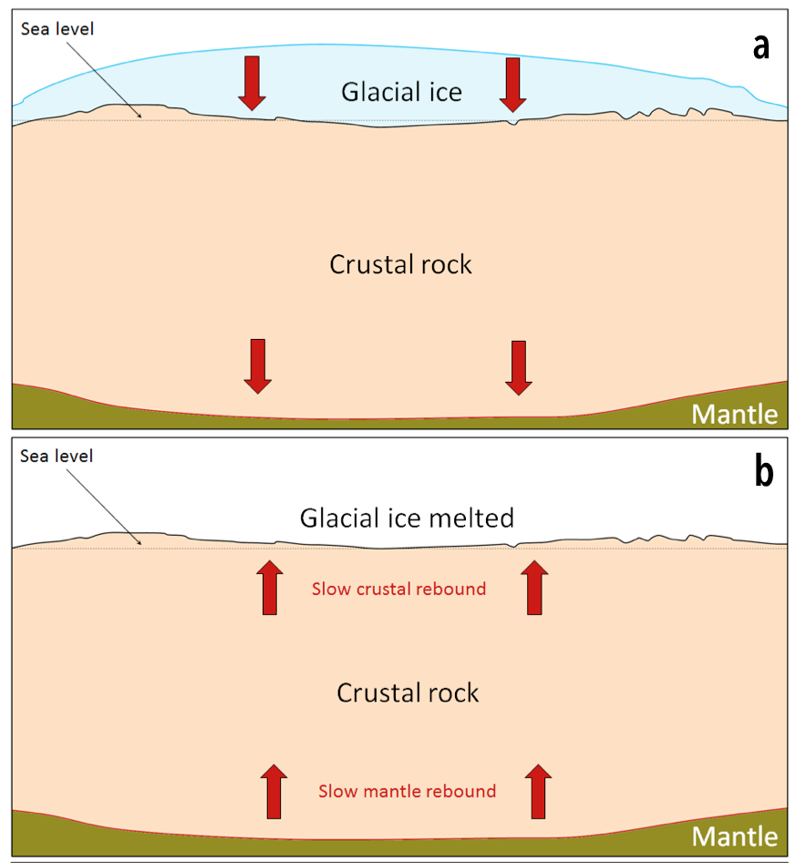
Crustal rebound continues from the last ice age!
This type of model is much more complex – but the idea is the same as our line-fitting example.
Spada & Melini (2019), https://www.mdpi.com/2073-4441/11/9/1844/htm

Slide 10
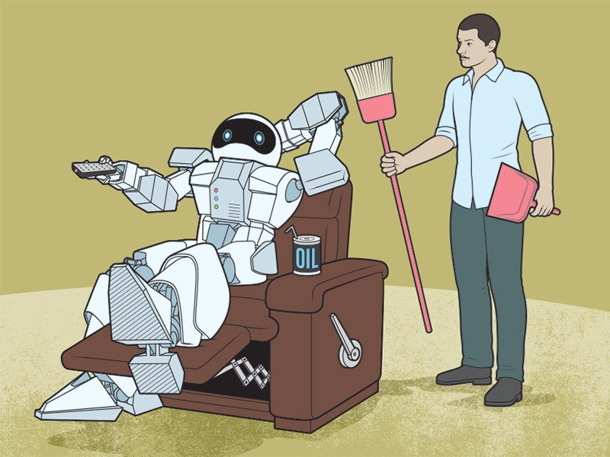
Computers are lazy…
They won’t do anything without our instructions! And if the instructions are too vague, they just give up…
We have to break a problem down into small steps
Example: get a drink of water: is it enough to say “pick up the water bottle and drink?”
A computer needs more steps:
Stand up
Walk 3 steps forward
Turn right 90 degrees
Walk 5 steps forward
Extend right arm
…

Slide 11
The four steps of programming
Understand the Problem
What is our goal? What are the obstacles? What are we starting with? Describe the issue to the best of your ability.
Devise a Plan
Have we seen this problem before? Can we break the problem down into smaller problems that are familiar and accessible?
Execute the Plan
Try to write a solution in terms of code. Don’t feel bad if you need to look up some (or many) commands.
Examine the Solution
Make sure you can explain the solution. Is it correct? What could be improved, if anything? Could we use this solution for other problems?
http://jarednielsen.com

Slide 12
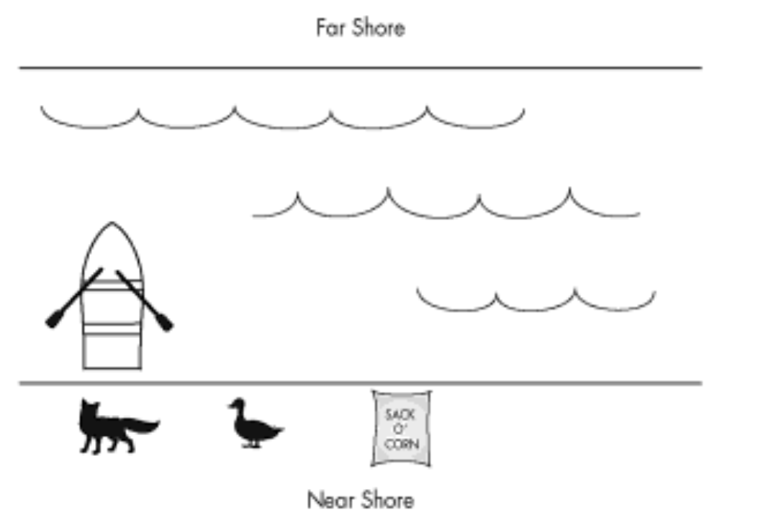
Programming is problem-solving
The fox, the goose, and the corn

Slide 13
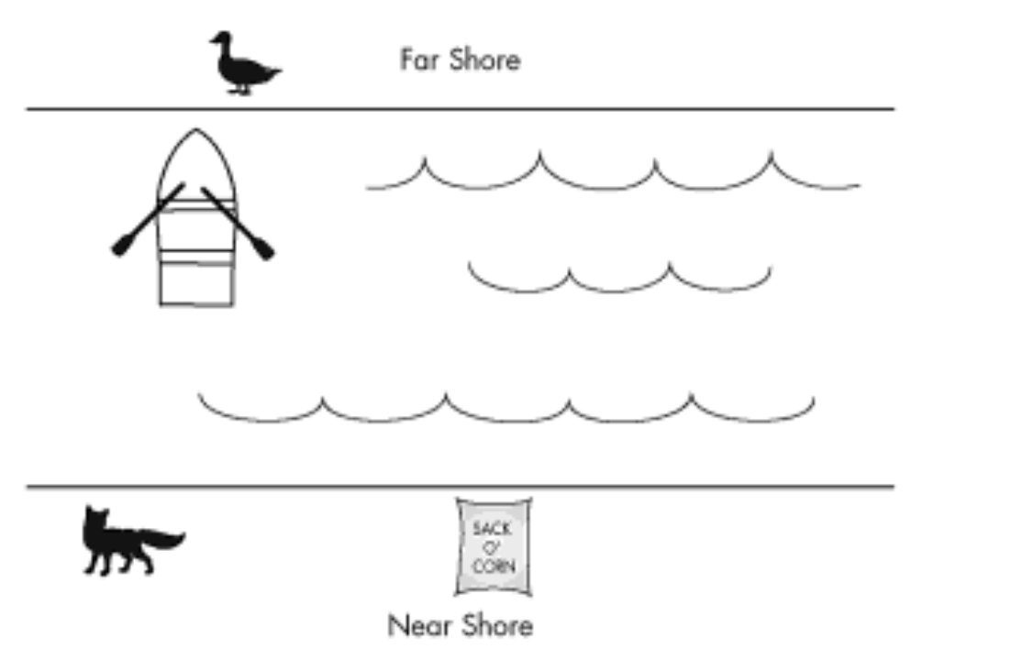
Programming is problem-solving
Bring the Duck across: D ↑

Slide 14
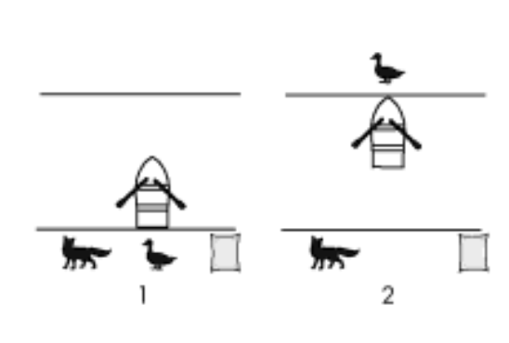
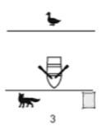
Programming is problem-solving
Come back with nothing.
What’s the next step?
D ↑
- ↓

Slide 15
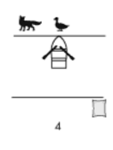
Programming is problem-solving
Bring the Fox across?
What’s the next step?
?
D ↑
- ↓
F ↑

Slide 16
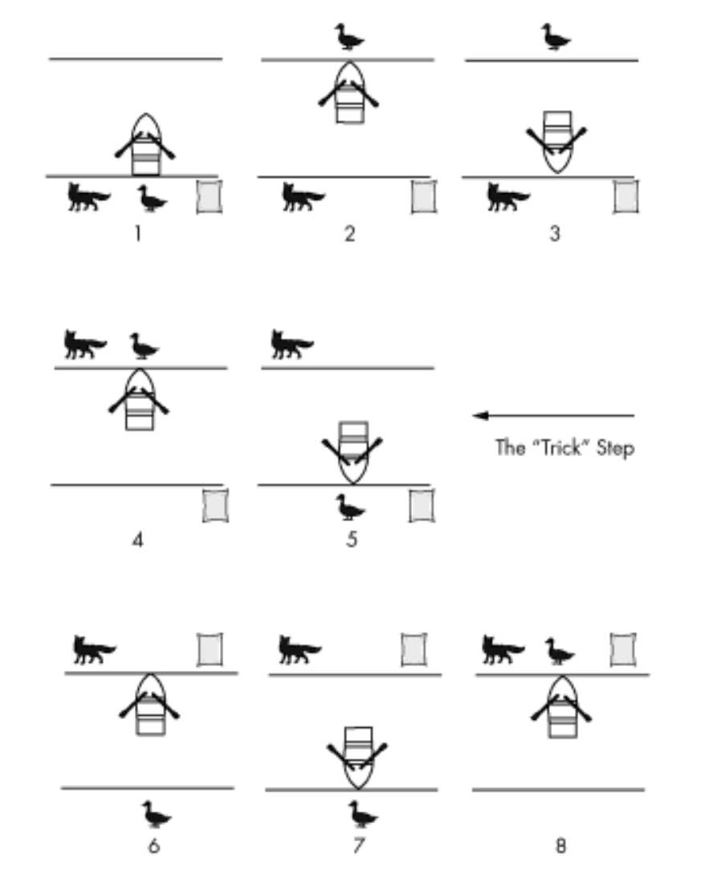
The solution:
D↑, -↓, F↑, D↓, C↑, -↓, D↑
Source: Think Like a Programmer: An Introduction to Creative Problem Solving, by Anton Sproul

Slide 17
The four steps of programming
Understand the Problem
What is our goal? What are the obstacles? What is the error message? Describe the issue to the best of your ability.
Devise a Plan
Have we seen this problem before? Can we break the problem down into smaller problems that are familiar and accessible?
Execute the Plan
Try to write a solution in terms of code. Don’t feel bad if you need to look up some (or many) commands.
Examine the Solution
Make sure you can explain the solution. Is it correct? What could be improved, if anything? Could we use this solution for other problems?
http://jarednielsen.com

Slide 18
An imaginary program to solve the fox, goose & corn:
Data to store:
Things on bank 1: [F,D,C]
Things on bank 2: []
Your location
Main program:
Choose something at random to bring from bank 1 to bank 2.
Are both banks safe? If not, go back one step.
Is everything on bank 2? If yes, you win!
Choose something at random to bring from bank 2 to bank 1.
Are both banks safe? If not, go back one step.
Is everything on bank 2? If yes, you win!
Repeat until you win.
http://jarednielsen.com

Slide 19
Programming is a language: it has both vocabulary and grammar
Concept hierarchy:
Statement: any command done by the computer
Variable: a value with a name, stored by the computer
Function: a collection of statements
Object: a collection of variables or functions
Module: a set of functions stored in a different file
Library: a module or modules written by someone else
Operations:
Test: if X is true, then do Y
Loop: do Y some # of times, or do Y until X is false

Slide 20
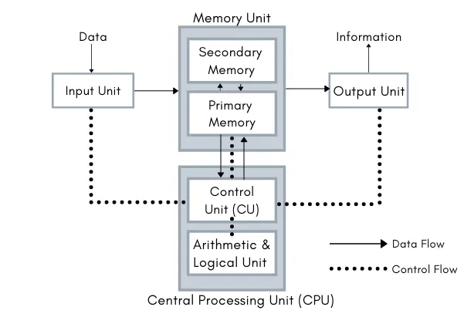
What’s inside a computer?
Keyboard, mouse, data files, etc.
Screen, speakers, data files, etc.

Slide 21
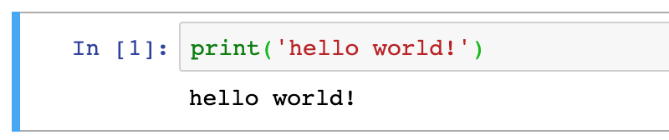
Statement: a command for the computer to execute
For example, the print: function
Keyboard, mouse, data files, etc.
Screen, speakers, data files, etc.

Slide 22
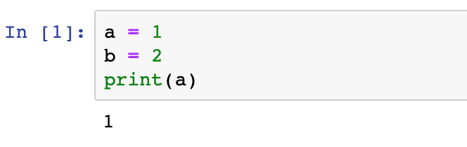
Variable: a value with a name, stored by the computer
Let’s assign a few variables, and then print one:

Slide 23
Variable: a value with a name, stored by the computer
How is a variable stored in the memory?
Memory Address | Data storage (bytes)
1000
1001 | 1
1002
1003
1004
1005
1006
……

Slide 24
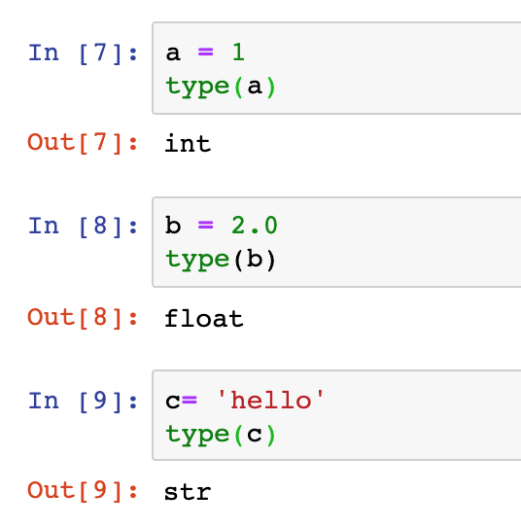
Variables can have different types: int, float, strings
We can check the type of a variable with the command type:
Inside the computer, different data types take up different amounts of memory. But their memory address works in the same way.
Memory Address | Data storage (illustration)
1000 | 1
1001 | 2
1002 | .0
1003 | h
1004 | e
1005 | l
1006 | l
…… | o

Slide 25
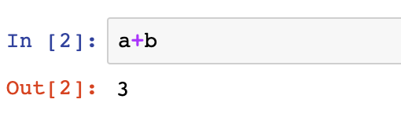
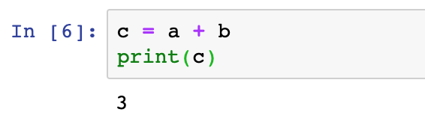
Variable: a value with a name, stored by the computer
We can do operations on variables:
Special note: in jupyter, running a statement by itself will automatically print the result. If you have several statements, you may need to use the print() command to view the results.

Slide 26
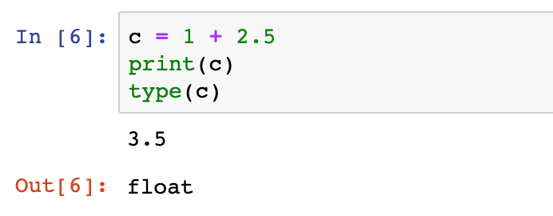
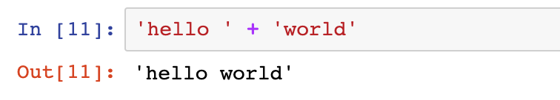
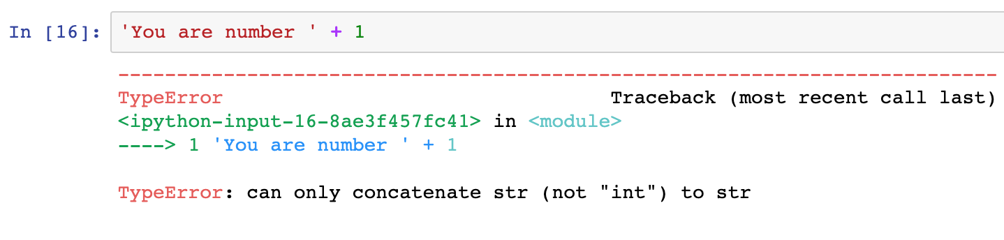
Adding different variable types:
Add an integer and a float:
Add strings together:
Can we add a number and a string?

Slide 27
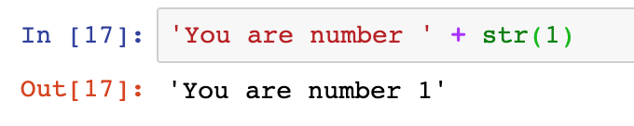
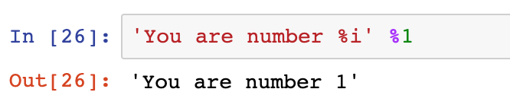
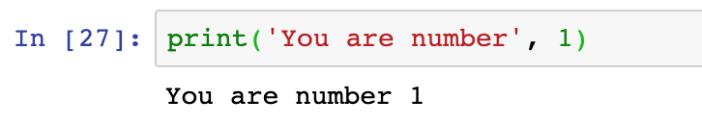
How to solve this?
One option: change the type of our number:
Another option: a “formatted” print statement. Format options: %i for integers, %f for float, %s for string
With the print command, we can also print more than one item:

Slide 28
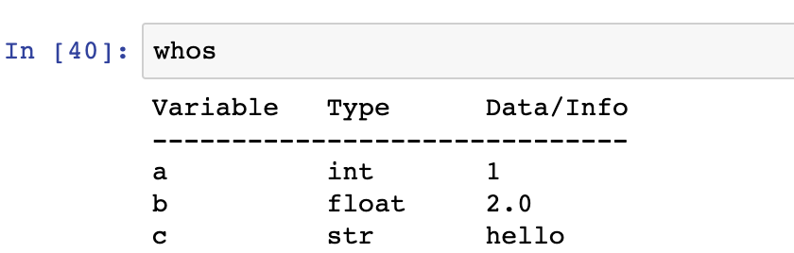
Get more information about our variables:
Use the python command whos:
Learn more about variables: https://www.learnpython.org/en/Variables_and_Types

Slide 29
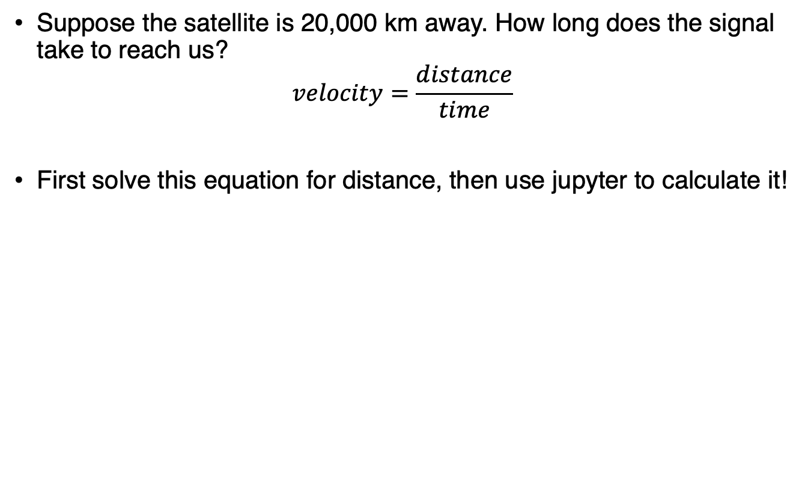
Solving a problem: how long does a GPS signal take to reach us?
Suppose the satellite is 20,000 km away. How long does the signal take to reach us?
$$velocity=\frac{distance}{time}$$
First solve this equation for distance, then use jupyter to calculate it!

Slide 30
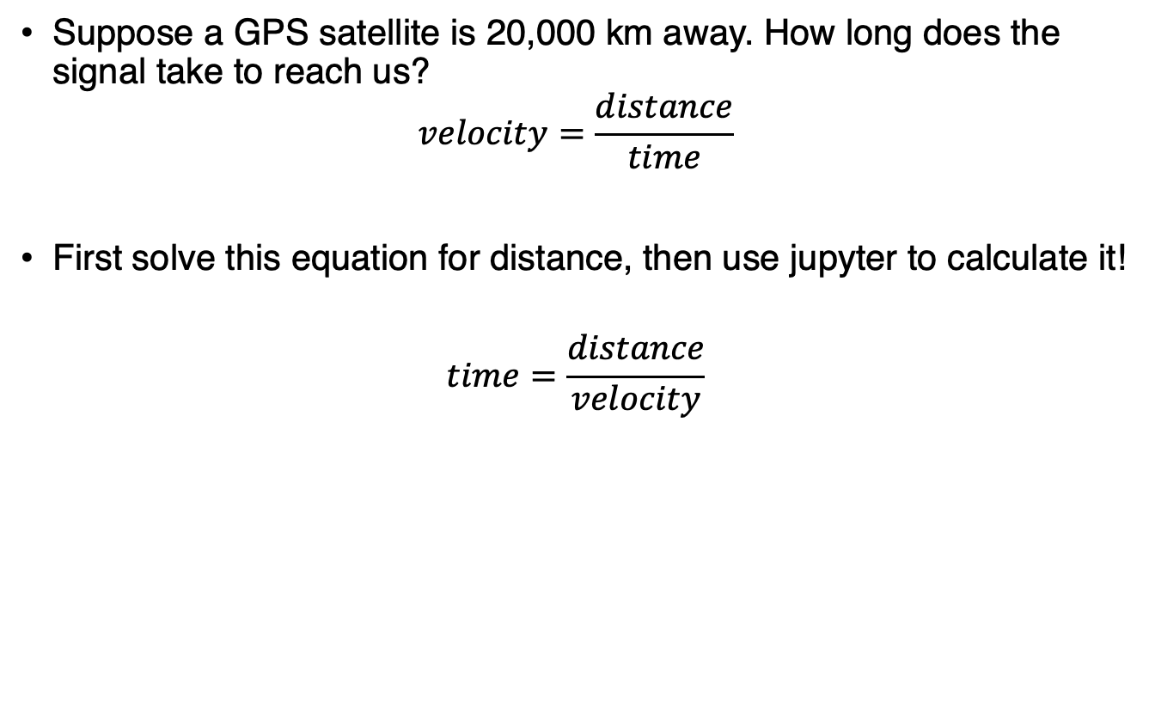
Let’s apply variables to solve a problem:
Suppose a GPS satellite is 20,000 km away. How long does the signal take to reach us?
$$velocity=\frac{distance}{time}$$
First solve this equation for distance, then use jupyter to calculate it!
$$time=\frac{distance}{velocity}$$

Slide 31
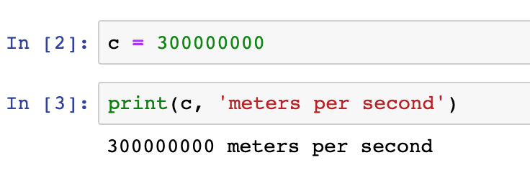
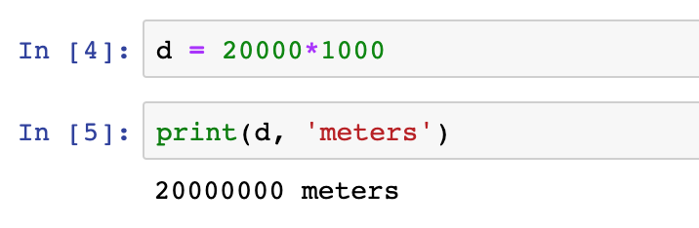
Let’s apply variables to solve a problem:
Assign the speed of light to a variable:
And the distance (20,000 km). *Why did I multiply by 1000?
Assignement: calculate how long the signal takes to reach us.
Can you print it out nicely formatted?

Slide 32
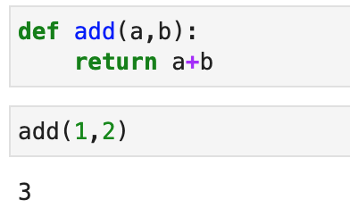
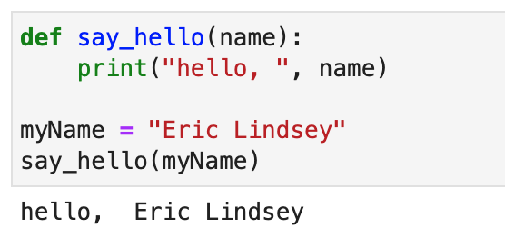
More advanced variables: functions
Instead of storing data only, we can store other things in memory too – like parts of a program!
Example: define a function for addition. Keywords are “def” and “return”. The colon and indentation are also required.
Functions can also operate on variables (or any type of data):

Slide 33
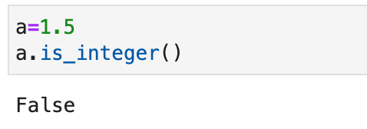
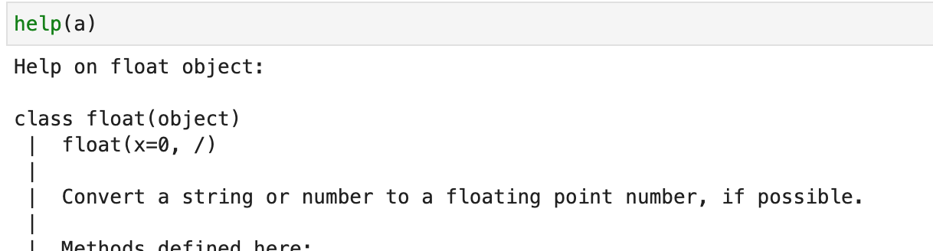
More advanced variables: objects
Objects are a grouping of variables and functions. In Python, everything is treated as an object, but we don’t have to worry about it.
Objects use the “dot” operator to access their components.
For example, the variable “a” is an object of type “float”. It has some methods we can access:
We can get more information about any object with help( ).

Slide 34
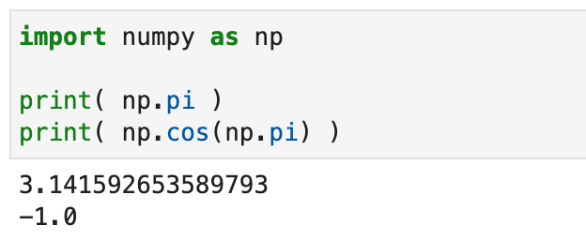
More advanced variables: modules
Modules are useful Python objects that define a large set of functions we might want to use.
Modules are stored on our computer as python files (.py), and must be store in a directory where python knows to look for them.
Manage installation via Anaconda Navigator to make life easier.
Example: numpy (Numerical Python library):
Try importing numpy and use help( ) to learn lots more!
Or get more help on the web: https://numpy.org/

Slide 35
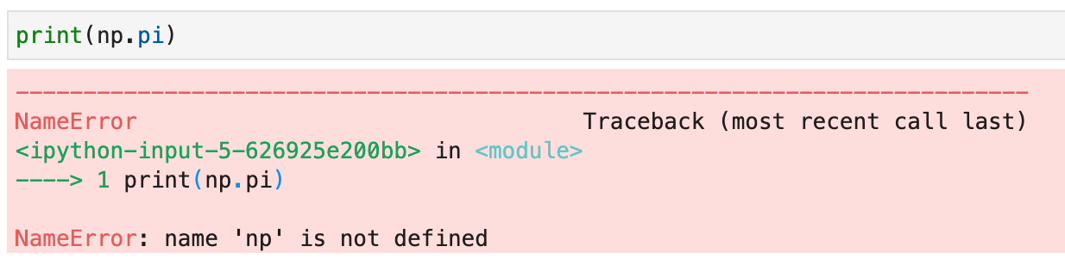
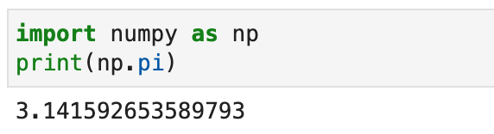
Errors and Bugs: Don’t Panic!
When programming, you’ll encounter lots and lots of bugs and errors. They can look scary:
Ack, what’s a “NameError” ???!!!
What happened? Start reading from the bottom of the error message: it tells us that np is not defined. Possibly we forgot to import numpy in this jupyter session?
Great, we’re all set!

Slide 36
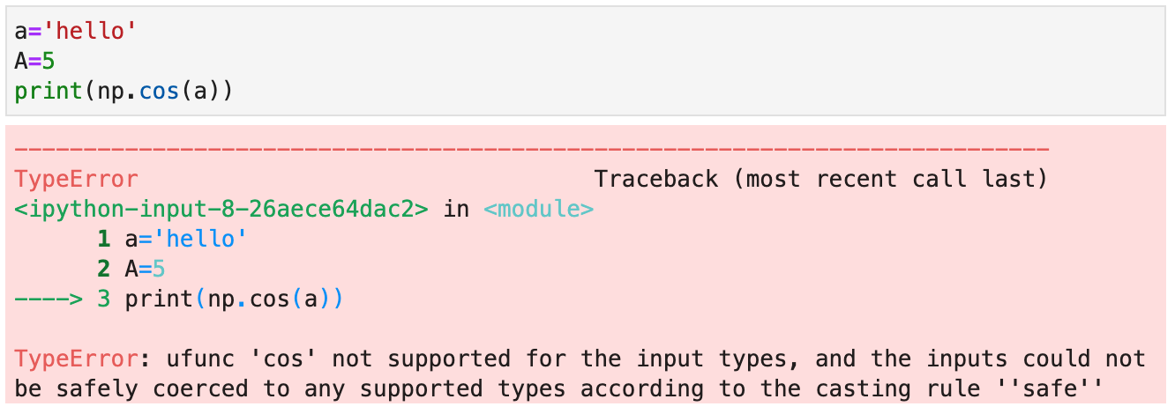
Errors and Bugs: Don’t Panic!
Sometimes the error message can be hard to decode.
In this case, reading the message could be pretty confusing. This type of error can be a puzzle – try to stay positive and see it as an opportunity!
Eventually, we realize our mistake: we meant to do np.cos(A), not np.cos(a). Python is case-sensitive!

Slide 37
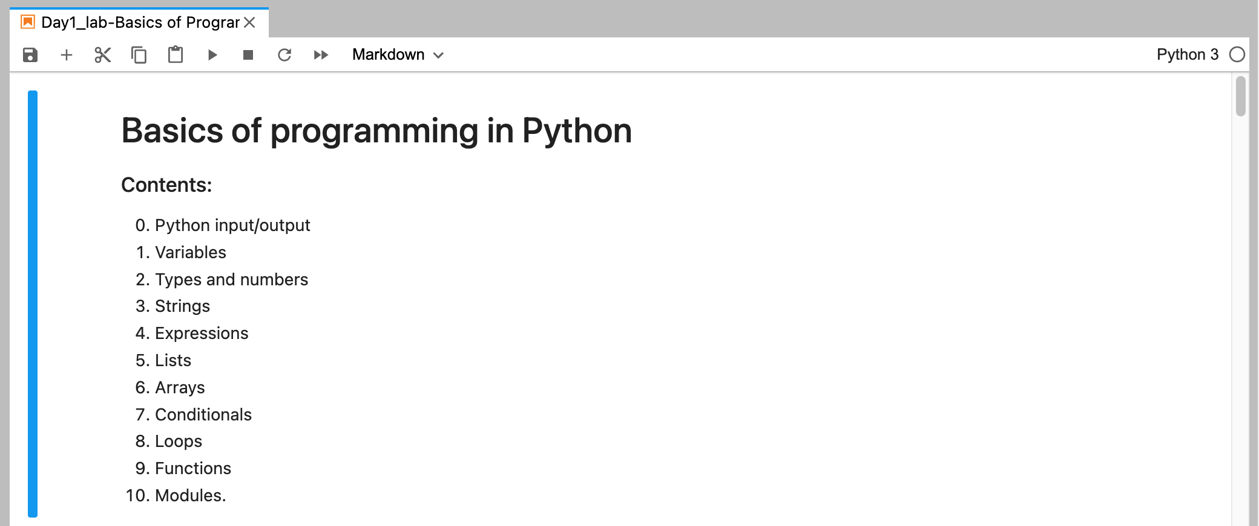
Your assignment:
Open Jupyter-Lab and go through the Day 1 exercises.
Be sure to run each of the cells to see the result, fix any bugs, and complete the assignments.
Don’t be shy – ask lots of questions to your neighbors, the instructors, and Google!

